Slide 1

Task 1 & 2 summary
Contents
Task 1 : Website creation using wix
Task 2 : Recreating the task 1 using,
1.Html
2.Css
3.Java script

Slide 2
Task 1 details
Website theme: Brewery & bar
Website : www.microbrewery.tk
Source : wix.com
Amount spent : 60 rs
Domain source : freenom.com

Slide 3
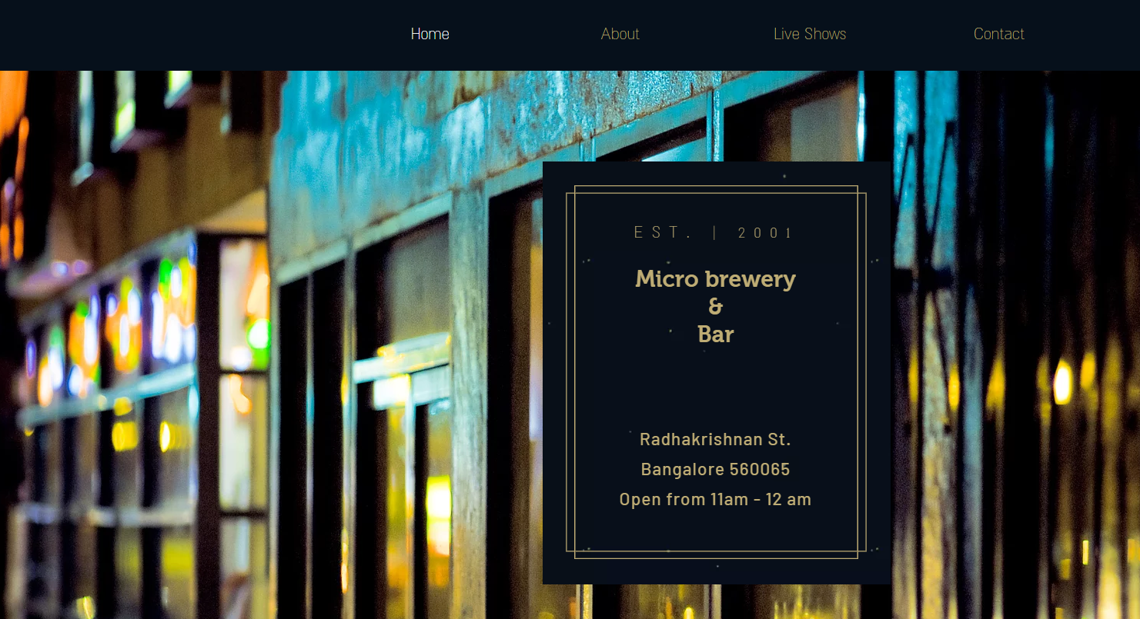
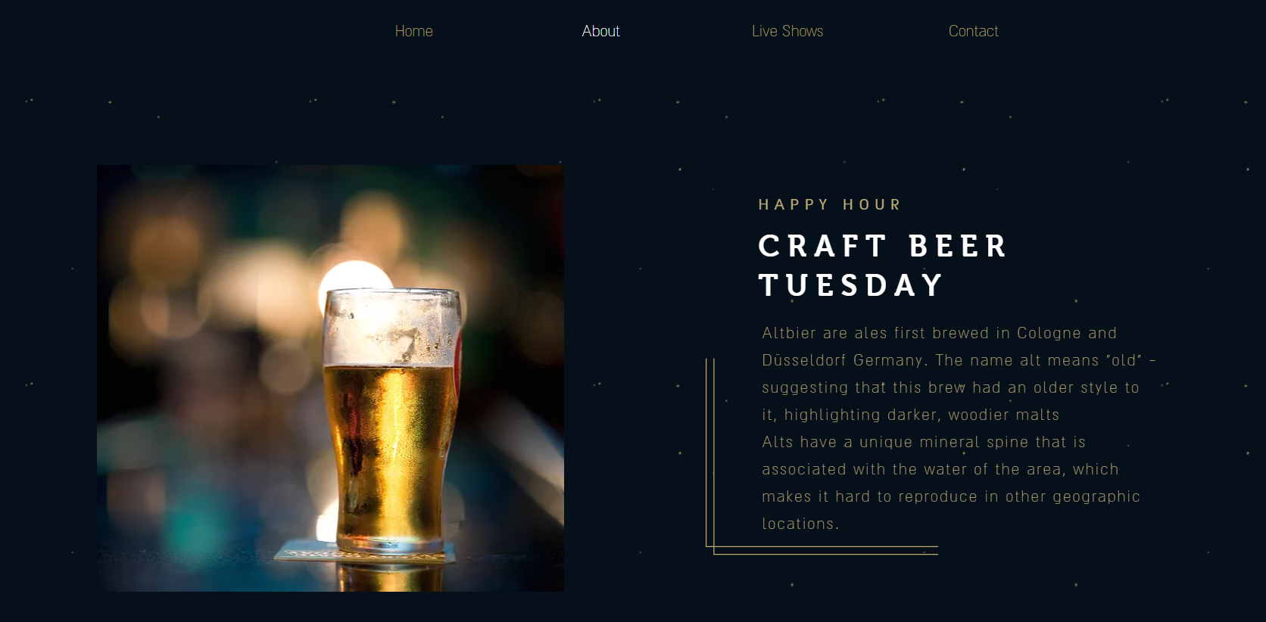
Preview of the Website

Slide 4
Knowledge acquired
Sources for creating websites
Hosting a website

Slide 5
Task 2 details
Recreating the website created in task 1
Used html,css and javascript in the website
Githublink: https://github.com/sethuraghavN/brewery.git

Slide 6
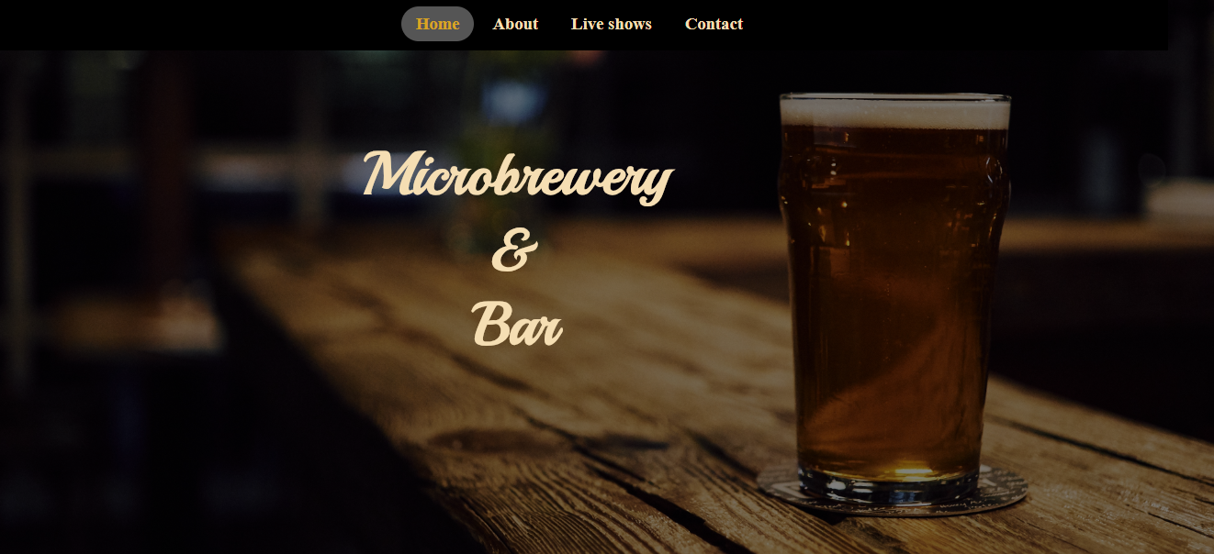
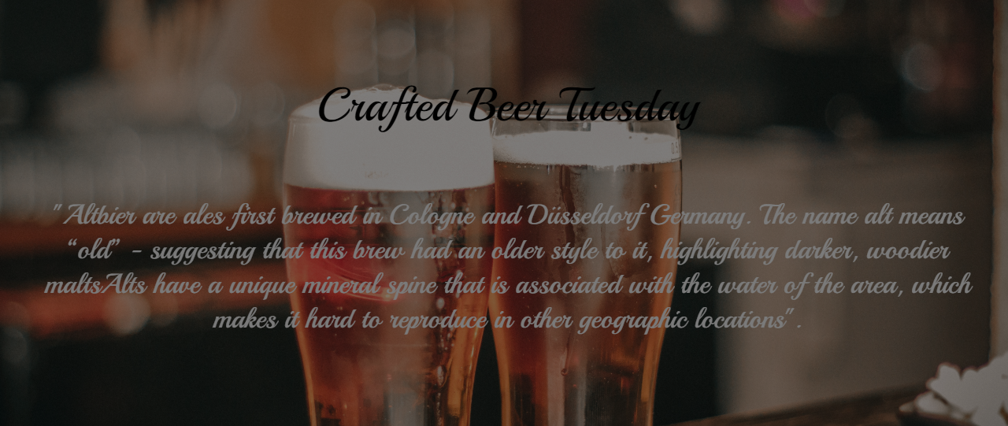
Preview Task 2

Slide 7
Software develop life cycle
Water fall method
Spiral model
V model

Slide 8
Water fall model

Slide 9
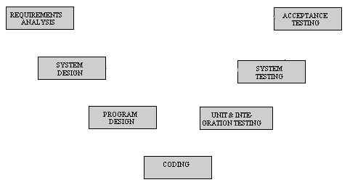
V model and spiral model

Slide 10
Knowledge acquired
Styling the websites
Java scripts functionality
Website alignment
Creating responsive websites

Slide 11
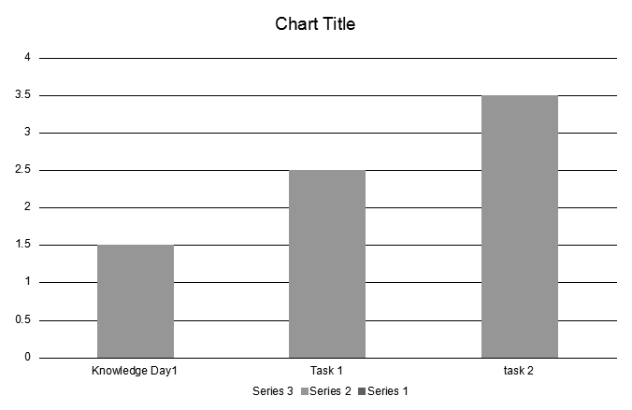
Summary of task 1 and task 2
learnt about different sources for website creation
Knowledge on existing technologies
Learnt how objects are used in a script and why they are used.
Learnt about how the websites are styled based on the needs

Slide 12
Task 3
Descrition :
Creating a card game using angular
Using bootstrap
Game theme : Memory game

Slide 13
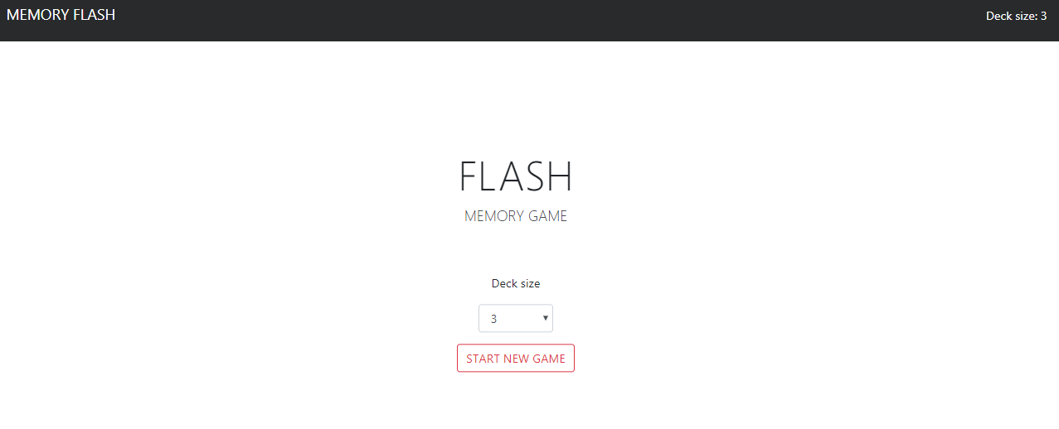
Game screeshots

Slide 14
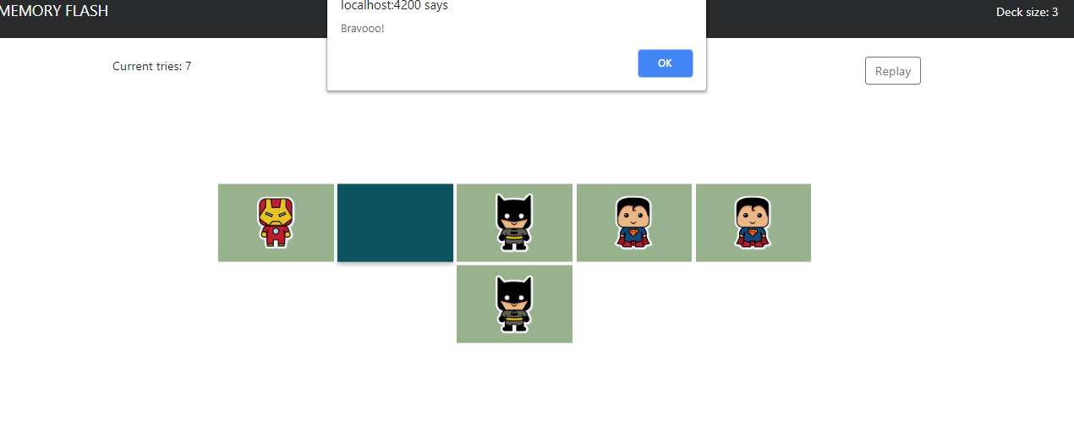

Slide 15
Summary
Leart basic understanding of angular
Learnt to implement bootstrap

Slide 16
Task 4
Description:
Creating a tool implemeting ITIL modules
Unitesting the product

Slide 17
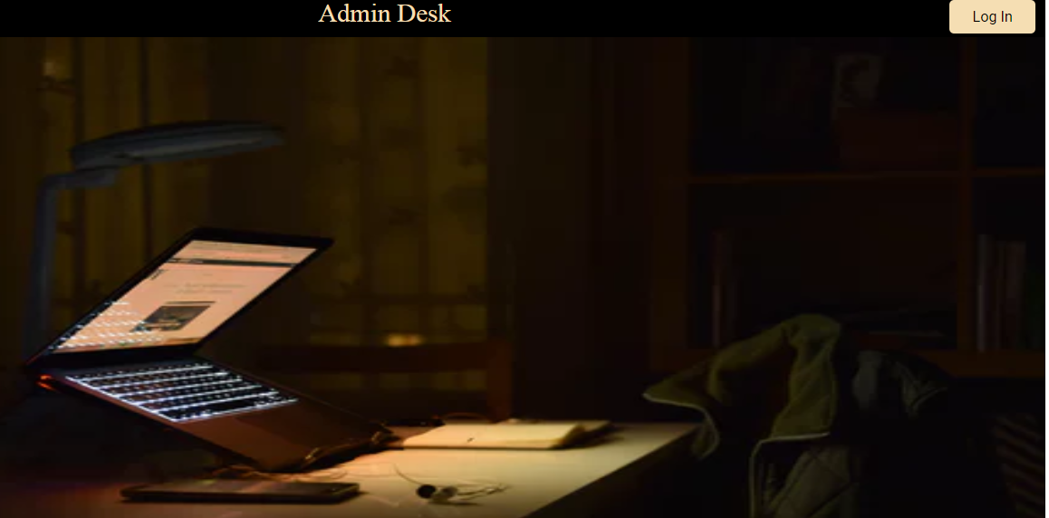
Screenshot :

Slide 18
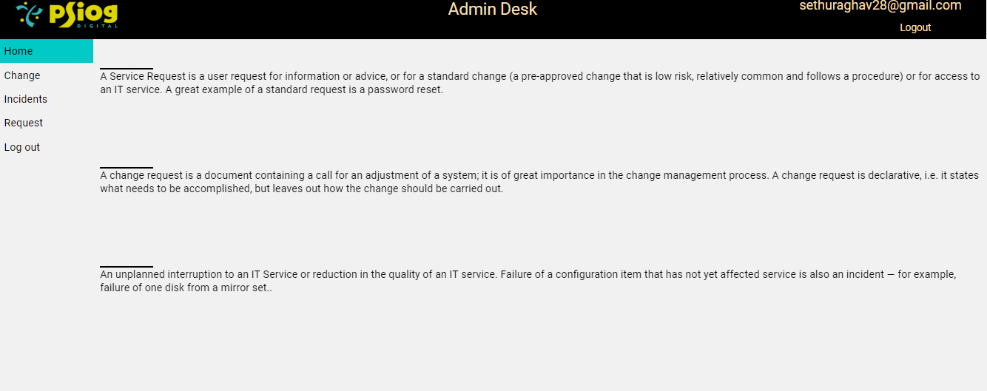

Slide 19
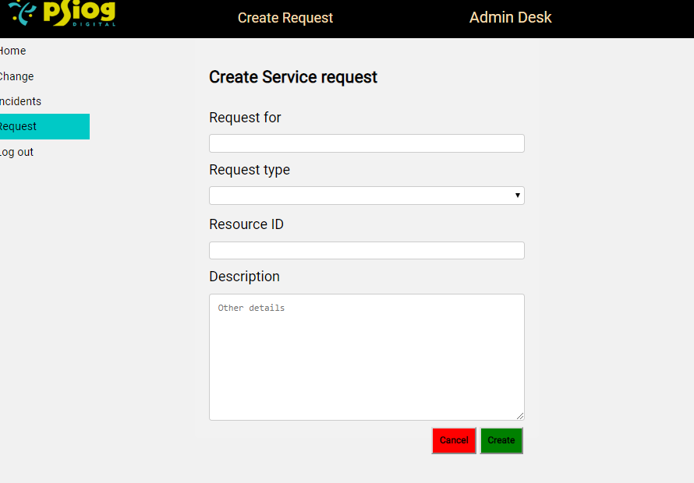

Slide 20
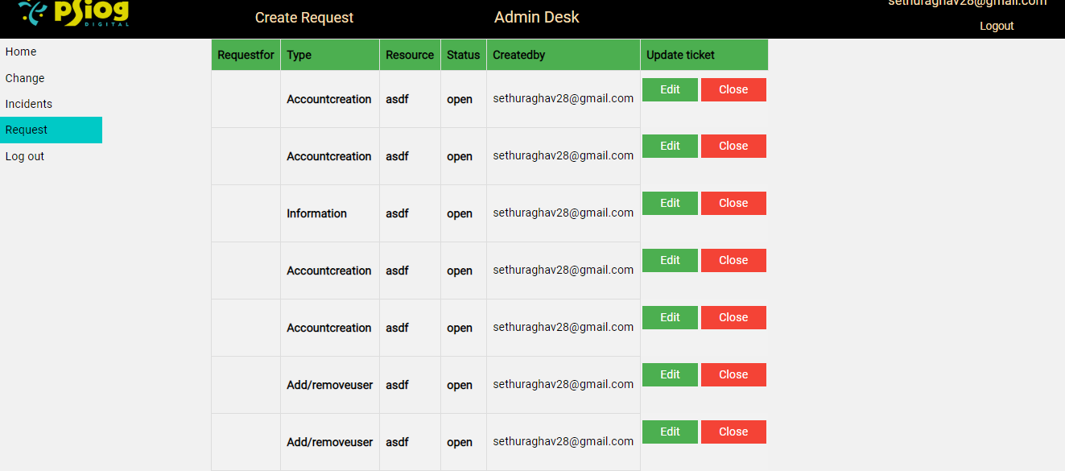

Slide 21
Summary
Learnt firebase and usage
Learnt about the Unitesting and tried testing process

Slide 22
Task5
Description:
Creating a inventory app with single user login
Creating a search function
Implementation of bootstrap

Slide 23
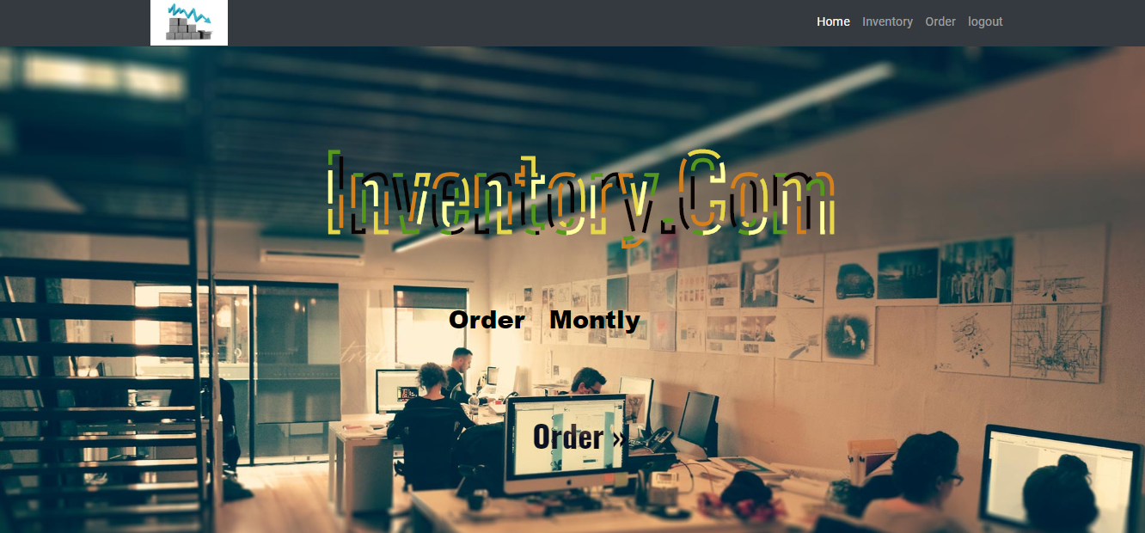
Screeshot:

Slide 24
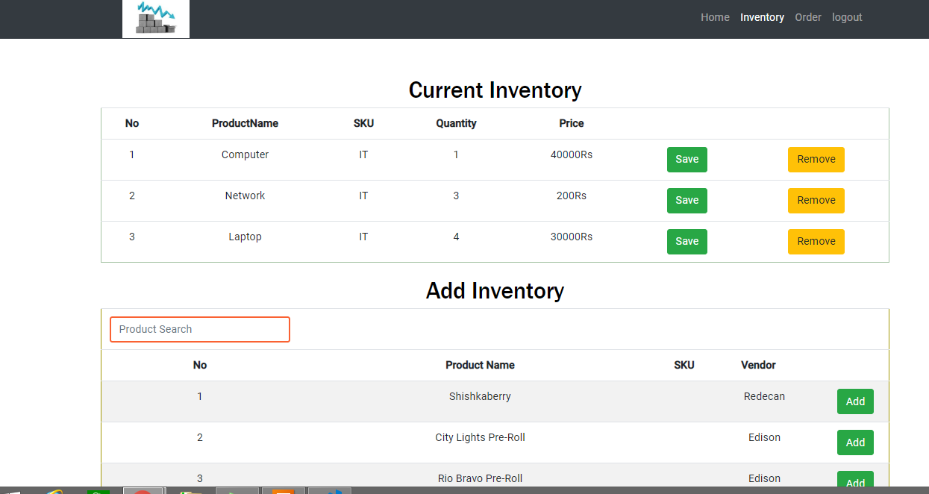

Slide 25
Summary
Learnt about json basics
Bootstrap implementation in different section

Slide 26
Git hub links :
Task 2: https://github.com/sethuraghavN/brewery
Task 3: https://github.com/sethuraghavN/card
Task 4: https://github.com/sethuraghavN/recreatee
Task 5: https://github.com/sethuraghavN/inventory-final

Slide 27
BPM task 1
Learning about BPM online
Product offerings
Features of BPM online

Slide 28
Task 2
Create a new Section “Request” with the below mentioned fields
→ “ Record Type “ lookup field with default value as “FOC”. Lookup values -- FOC, Fare Rule waver, Ground Services, Upgrade
→ “Account” lookup field
→ “ Department” Lookup field with values “ Dept 1”, “Dept 2” , “Dept 3”
→ “ Location” lookup field with values “HQ” ,“SG”, “TH”
→ “Owner” lookup field with contact values. Set the default value as the current contact user
→ “Request Date “ . Default date set as current date
→ “Class of FOC” lookup field with values “First”, “Second”, “Third”
→ “ Activity Type” lookup field with values “ Type 1”, “Type 2”, “Type 3”
→ “Justification” text field with more than 500 characters
→ “Approval status” lookup field with Request Created, Line Manager Approval, CCO Approval, CEO Approval, “Resolved”, “Canceled”

Slide 29
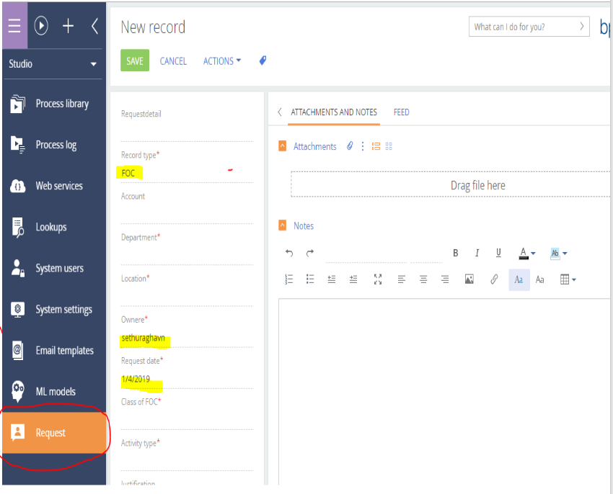
Task 2 Demo:

Slide 30
Task 3
In the section created earlier, create a case life-cycle to know the progress of the approval - from Request created to CEO approved. ( see attachment)
Using business processes, create Email Notifications at each stage, approve the process by each User and update the status on the section.

Slide 31
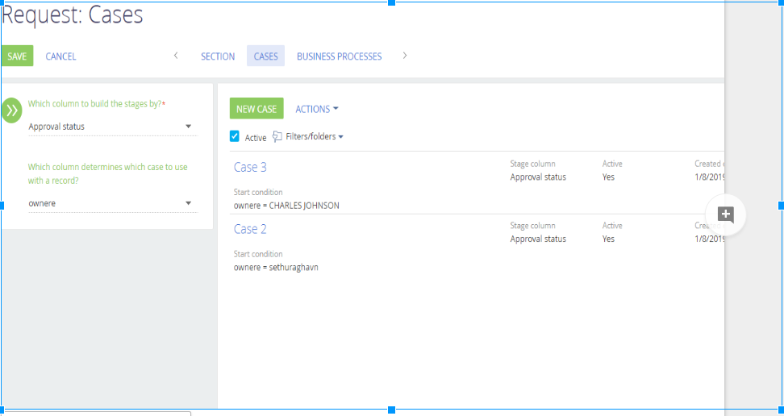
Task 3 Demo:

Slide 32
Task 4 : Business rules
a. When the value of the “Status” field is either “Canceled” or “Resolved” the “Owner” field is no longer available for editing.
b. If value of the “Satisfaction level” field is lower than 5, then the “Feedback notes” field becomes required.
c. If value of the “Status” field is “Resolved”, then “Satisfaction level” and “Feedback notes” fields become visible to the user (in all other cases they are invisible to the user).

Slide 33
Task 5
Create a web form to fetch the customer details and capture the details in the leads section via landing pages in BPM'Online.

Slide 34
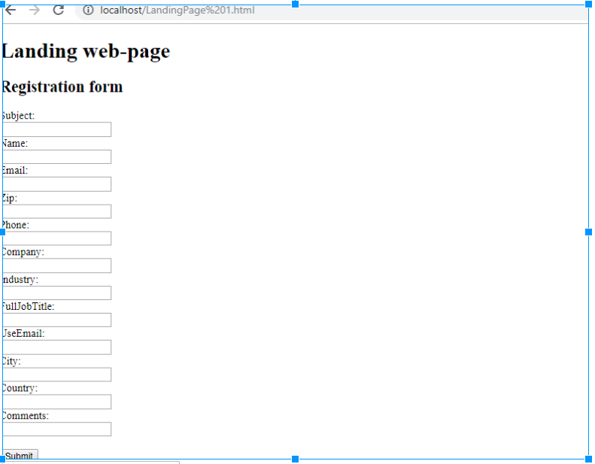
Task 5 Demo :

Slide 35
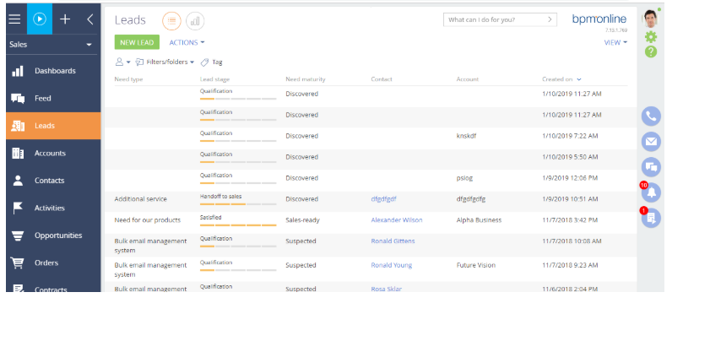

Slide 36
Task 6
Create web service using the given api to fetch the details( Location and address details of Post Offices in the given Pincode) and store it in a separate custom section (create related fields in the section to store the details).

Slide 37
Learnings
Steps done :
1.Created custom section in service product instance
2. Created webservices using the documentation mentioned below ,
https://academy.bpmonline.com/documents/administration/7-13/setting-web-service-methods
3.Created business rules to fetch the json data API
Difficulties faced and solution tried :
Unable to store the data in DB :
Tried to deserialize the array and save as object , still same issue
Unable to fetch the api data in trial instance :
Tried different API links and still unable to fetch the data hence unable to find the resolution

Slide 38
Task 7
Each opportunity can have multiple products.
Each product can have quotes from multiple supplier for each opportunity.
Once a quote is added for one opportunity for one product it should automatically come to opportunity quote detail.
When the user changes a particular quote to win yes, then the quote price should automatically go to opportunity product detail.
Once the price changes in opportunity product detail it should create purchase and sales order

Slide 39
Requirement met:
Created oppurtunity with feature to add multiple product
Quote added to product should come quote details in opportunity quote
Once the quote is approved win yes it should be added to order
Challenges faces :
Unable to map values between two cases

